Slide 1
Flower Recognition System Based On Image Processing
Course Name : Computer Vision And PATTERN RECOGNITION
Sec : B
Group No : B
Group Members :
Asadur Rahman ( 18-37447-1)
Shazzad Hossain Shovon ( 17-34884-2)
Mahmud Hasan ( 17-33881-1)
Md.rashedul islam ( 19-40559-1)
Sk.Mohiuddin ahmed ( 19-40126-1)

Slide 2
Flower Recognition System Based On Image Processing
CNN ( Convolutional Neural Network ) :
A convolutional neural network (CNN) is a type of artificial neural network used in image recognition and processing that is specifically designed to process pixel data.
CNNs are powerful image processing, artificial intelligence (AI) that use deep learning to perform both generative and descriptive tasks, often using machine vison that includes image and video recognition, along with recommender systems and natural language processing (NLP).

Slide 3
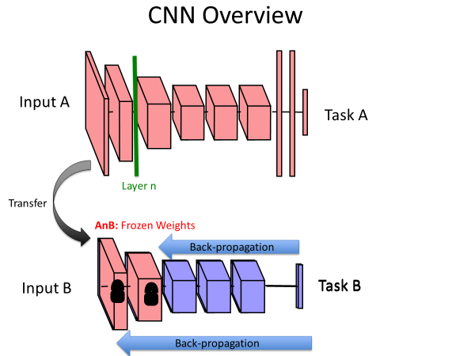
Flower Recognition System Based On Image Processing

Slide 4
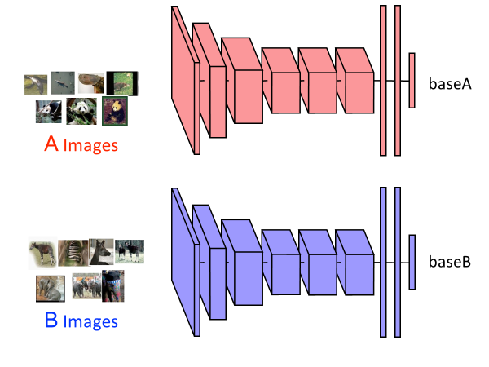
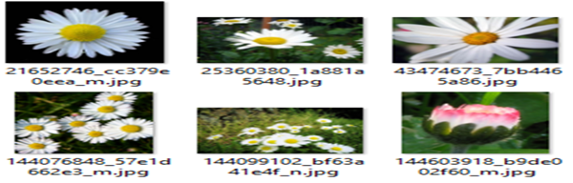
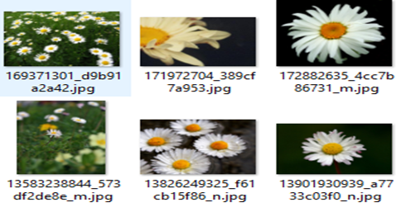
Flower Recognition System Based On Image Processing

Slide 5

Flower Recognition System Based On Image Processing
Project Working Procedure :
Input Image
Feature Extraction
Image Analysis
Pre-processing
Training
Testing
Apply CNN Theory
Output

Slide 6
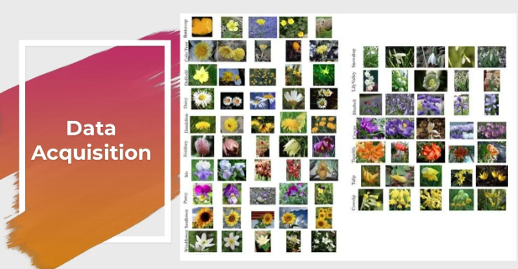
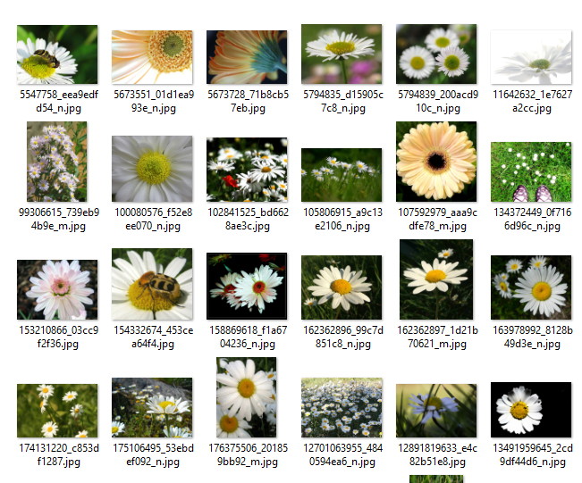
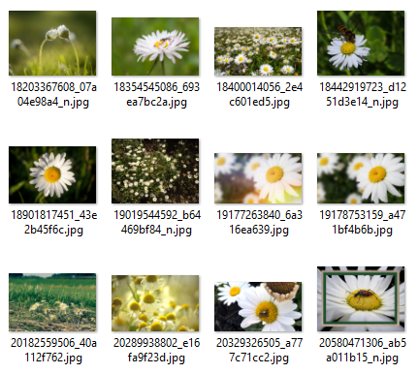
Flower Recognition System Based On Image Processing

Slide 7

Flower Recognition System Based On Image Processing

Slide 8

Flower Recognition System Based On Image Processing

Slide 9
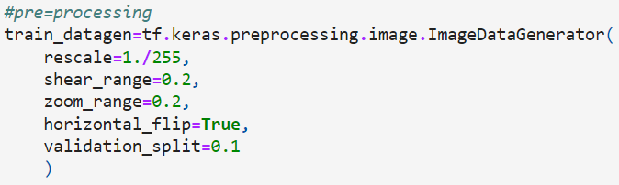
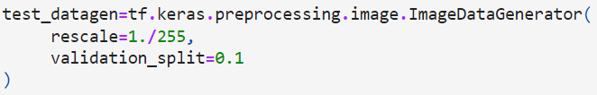
Pre-processING
We use keras for pre-processing
Img_size = 224
Batch_size = 64
Take 10% of the data for testing

Slide 10
Model building
We us sequential model
Karne_size=3
Layers-
Conv2D
MaxPol2D

Slide 11



Flower Recognition System Based On Image Processing

Slide 12

Flower Recognition System Based On Image Processing
Project Data Set :
Total Number Of Images : 477
Train in Purpose : 431
Test : 46
Datasets : 1
Class: 4(Daisy, Dandelion, Roses, sunflowers)

Slide 13

Flower Recognition System Based On Image Processing
Project Working Procedure Using CNN :
In our project we use python .

Slide 14

Flower Recognition System Based On Image Processing
Accuracy Test :
Here Using CNN we find the accuracy Rate is 0.7174%

Slide 15

Flower Recognition System Based On Image Processing
Conclusion :

Slide 16


